Slide 1
EMISSION IMPOSSIBLE: Decarbonizing Energy
Carbon Negators:
Jessica Boyette Hunter Kaminski Alyssa Morea Michael Orense
Notes:
Hello, my name is Alyssa Morea, I am project lead for our team the Carbon Negators.
*INTRODUCTIONS*
I’ll be discussing our proposal Emission Impossible on decarbonizing energy.

Slide 2
CURRENT PROBLEMS

Slide 3
Environmental Concerns
Air
Groundwater
Wastewater
Solid Waste

Slide 4
Public Health
Notes:
What does all of this pollution mean to public health? We’ve seen that greenhouse gas emissions are extensive, and greenhouse gas is the driving force behind global warming and climate change. That means for us: increased heat related deaths, increased spread of infectious diseases, poorer crop yields, and more extreme weather events. Additionally, air pollution, particularly PM, can wreak havoc on

Slide 5
Policies & Regulations
NESHAP
Greenhouse Gas Reporting Program
Clean Air Act
New, Existing Source Performance Standard
Clean Power Plan
Affordable Clean Energy Rule
Source https://www.epa.gov/:

Slide 6
Proposed Solutions
Notes:
We propose a two phase approach. Our first phase focuses on preventing more CO2 from entering the atmosphere by retrofitting current technologies with newer carbon capture systems. Our second phase will transition us into an age of renewable energy, where we have a decreased dependence on coal and a more diverse energy portfolio

Slide 7
Phase 1:
Fixing Current Emissions
Present-2030
Notes:
Phase one will be from now until 2030 and it starts with...Metal organic frameworks
Neutralizing current carbon systems

Slide 8
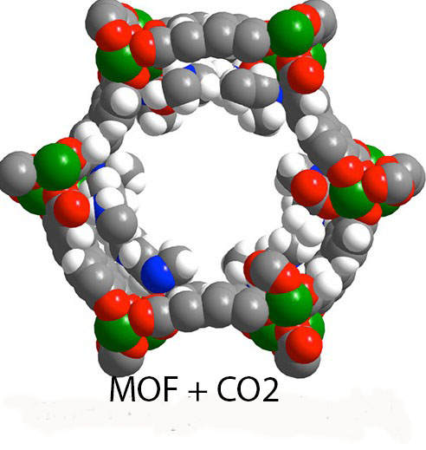
MOFs
Metal Organic Frameworks
Metal center surrounded by organic “linker” molecules
Selective absorption, >90%
Tailored to specific environments
Comparably smaller thermal swings during CO2 separation
¼ Energy consumption
⅓ Operating cost
ExxonMobil collaboration with Berkeley lab
$10B from ExxonMobil since 2000
C
Mn
H
O
N
Source: Yarris. “A Better Way of Scrubbing CO2,” 2015, https://newscenter.lbl.gov/2015/03/17/a-better-way-of-scrubbing-co2/ Accessed 25 Oct 2020
An appended diamine molecule attached to a manganese-based MOF
Notes:
assuming an average of 2 columns per plant, each plant would sequester 18.4 tons of CO2 per year
compared to just under 1 ton of CO2
MOFs are a better way to scrub CO2. A Lab at UC Berkeley appended a diamine molecule to make it hydrophibic. this allows for highly selective absorption.
Compared to traditional amine scrubbers, which only scrub about 80% of CO2 and require large thermal swings to regenerate the amines, MOFs capture greater than 90% CO2 and don't require large thermal swings. MOFs are also extremely stable and are less likely to leak carbon after regeneraton
all of this translates into ¼ of original energy cost and a lower lower operating costs .
The future of MOFs is bright, exxonmibil collaborated with the berkely lab and has given over $10B over 20 years to projects like ours and they are promising to do so through 2050., so we expect to receive the necessary funds for our project

Slide 9
CMAP
Carbonate Mineralization by Aqueous Precipitation
Uses captured carbon to create carbonate coatings around aggregates for concrete
Work in conjunction with Blue Planet or Carbon Cure
Concrete utilized for future infrastructure and developments
Removes dependence on limestone and dolomite mines
O
N
Source: “Blue Planet | Economically Sustainable Carbon Capture.” Blueplanet-Ltd.Com, 2016, www.blueplanet-ltd.com/#technology. Accessed 23 Oct. 2020.
Carbonate Coatings are 44% CO2 by mass
Notes:
Makes stronger aggregates (needing less cement)
Preserves natural springs caves etc.
Sell MOF Captured Carbon

Slide 10
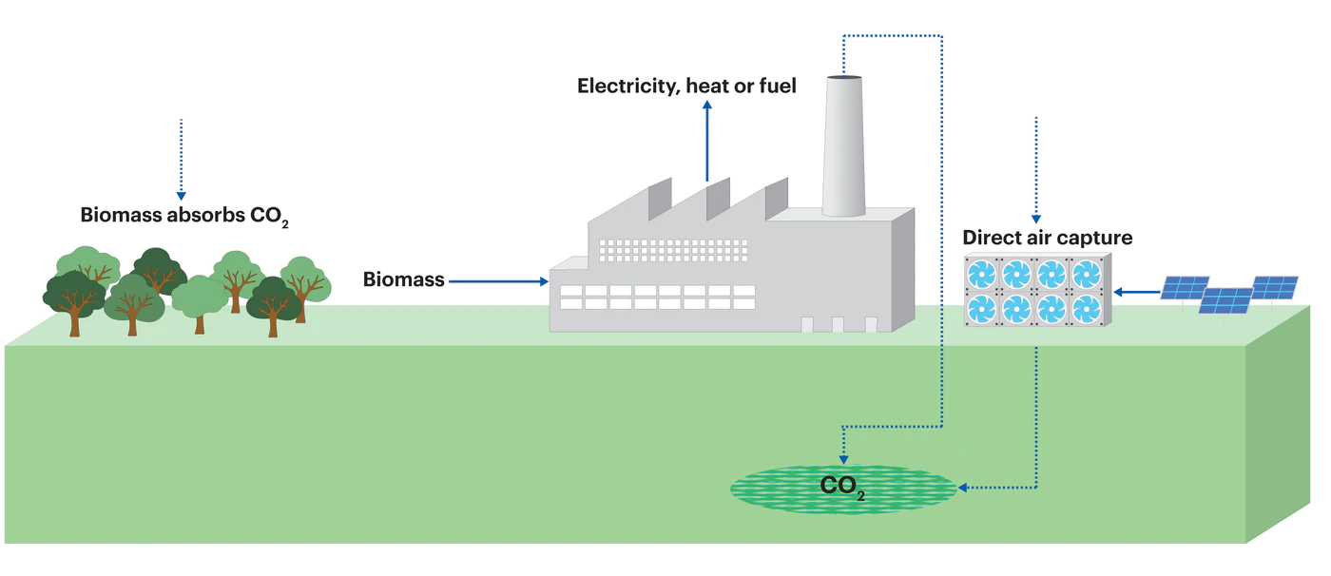
BECCS
Bioenergy Carbon Capture and Sequestration
Biomass veg. sequesters atmos. carbon to then be utilized in biomass plants
Capture post-combustion emissions
Carbon Negative technology
Cofiring coal plants can be carbon neg.
The Carbon Utilization Act of 2018
Loan guarantees
O
N
Source: Going carbon negative: What are the technology options? – Analysis - IEA. “Going Carbon Negative: What Are the Technology Options? – Analysis - IEA.” IEA, 2020, www.iea.org/commentaries/going-carbon-negative-what-are-the-technology-options. Accessed 23 Oct. 2020.
Graphical demonstration of process
Notes:
2.99 metric tons annual through amine sequestration which is 10% less efficient at capturing carbon

Slide 11
BUDGET- PHASE 1
1,002,400,000
MOFs
$1,000,000,000
MISC
$1,100,000
CMAP
$1,400,000
BECCS
$1,000,000
Not to scale
Notes:
Our overall budget for phase 1 is just over $1B. while this initially seems like a pricey project, A large portion of the cost will be offset by research and development grants from companies, such as exxonmobil. Also the captured CO2 will then be sold to other companies to make economically productive materials, which will further offset the large cost of this project. For CMAPs, we’ll make money from selling to companies(blue planet and carbon cure), and even if we can't sell as much as we want, we have funds set aside to develop an aggregate coating plant to utilize in development sites. to fund beccs, we rely on US dep of Agriculture, which guarantees loans to projects like ours. But even if those loans are not sufficient, we have funds reserved to supplement these loans
CMAP- funds reserved if we cant sell to CMAP companies (Blue Planet or Carbon Cure) and need to develop an aggregate coating plant to utilize in development sites
BECCS- have loan guarantees from US dep of Agriculture, have funds reserved if loans are not sufficient
NOTE WHERE THE FUNDING IS COMING FROM!! (we can just verbalize it, no need to write it down)
MOF cost offset by ExxonMobil funding (don't worry)
assuming an average of 2 columns per plant, each plant would sequester 18.4 tons of CO2 per year
compared to just under 1 ton of CO2 per tree after 40 years
BECCS US$100–200 per ton of CO2 sequestered and another projecting costs of US$20–100 per ton 5,000 tons sequestered

Slide 12
Phase 2: Shift to Renewables
2030-2050

Slide 13
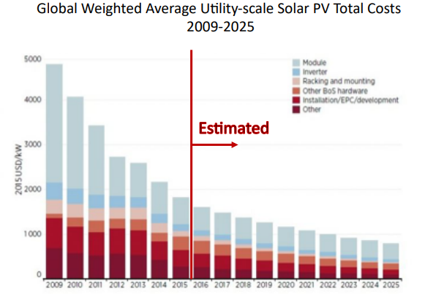
Solar
Conventional Photovoltaic (PV)
Lowering installation costs
Dye-sensitized Solar Cells (DSSCs)
Low cost mass production
Doesn’t absorb infrared
Source https://www.irena.org/publications/2020/Jun/Renewable-Power-Costs-in-2019
Sources: http://www.joshuagallaway.com/?p=479
Demonstrated beauty of DSSCs
Notes:
Butler plaza largest in SE Cover over 245,000 sqf(roof)
$6.8 Million Construction Loan
2.2 MW Rooftop Solar System

Slide 14
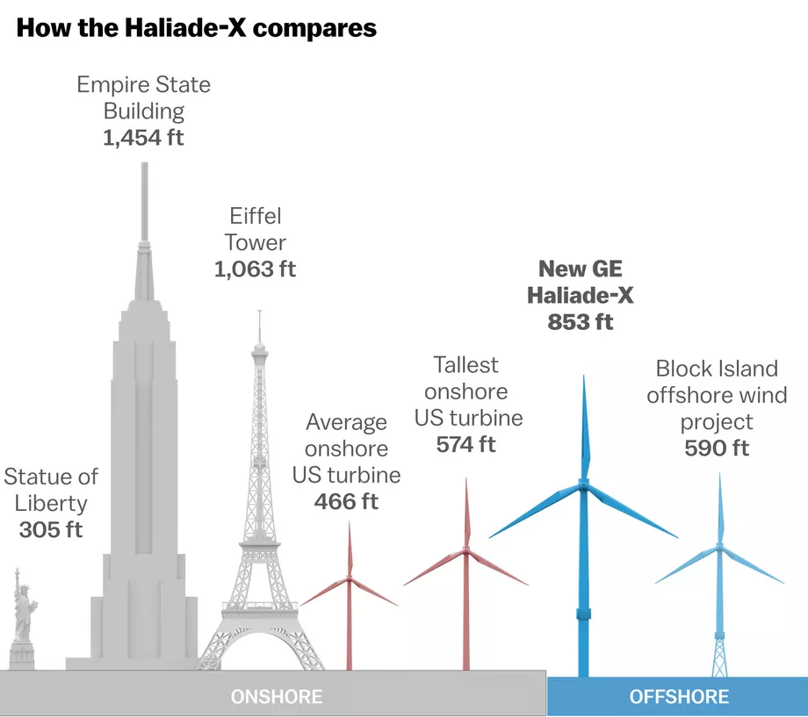
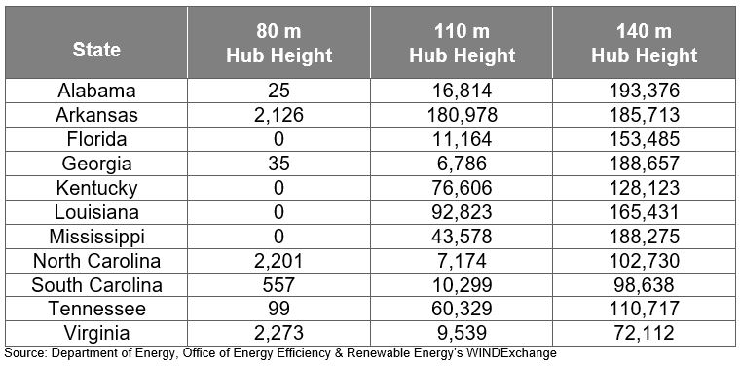
Wind
Conventional (Onshore) wind power
Lagging
Recent technological developments
Conventional (Offshore) wind power
Resistance in areas with intense tourism
Kite Wind Power
Fledgling stages of development
Multiple benefits over conventional wind
Source:https://www.vox.com/energy-and-environment/2018/3/8/17084158/wind-turbine-power-energy-blades
Source:https://www.google.com/url?q=https://www.scottmadden.com/insight/understanding-wind-energy-potential-southeast/&sa=D&ust=1603857599982000&usg=AFQjCNFUOxI5j_SPa91Y0OyavdcRuKjGcA
Notes:
Has lagged behind the rest of the country in onshore wind power generation

Slide 15
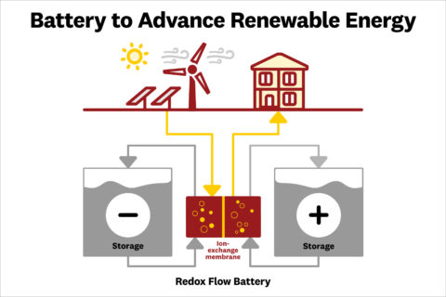
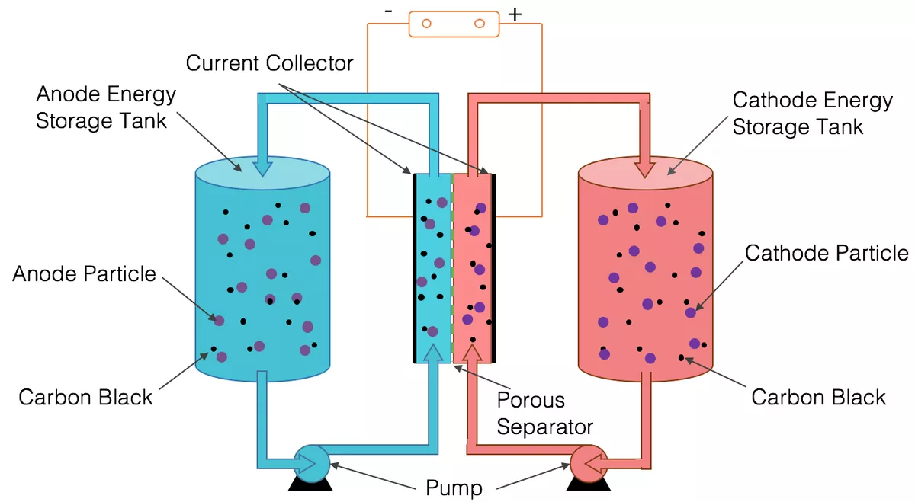
RBFs
Redox Flow Batteries
Flowing electrolyte tanks, can be charged or discharged based on flow direction
Long life-cycle
High discharge rates
Scalable energy and power features
Safe design
USC cheap design
O
Source https://news.usc.edu/166306/flow-battery-renewable-energy-electricity-storage-usc-study/
N
Source: Roberts, D. (2018, September 20). A tiny, beleaguered government agency seeks an energy holy grail: Long-term energy storage. Retrieved October 26, 2020, from https://www.vox.com/energy-and-environment/2018/9/20/17877850/arpa-e-long-term-energy-storage-days
Graphical demonstration of design
Notes:
USC iron sulfate (cheap waste prod of steel industry) $60-70/kWh

Slide 16
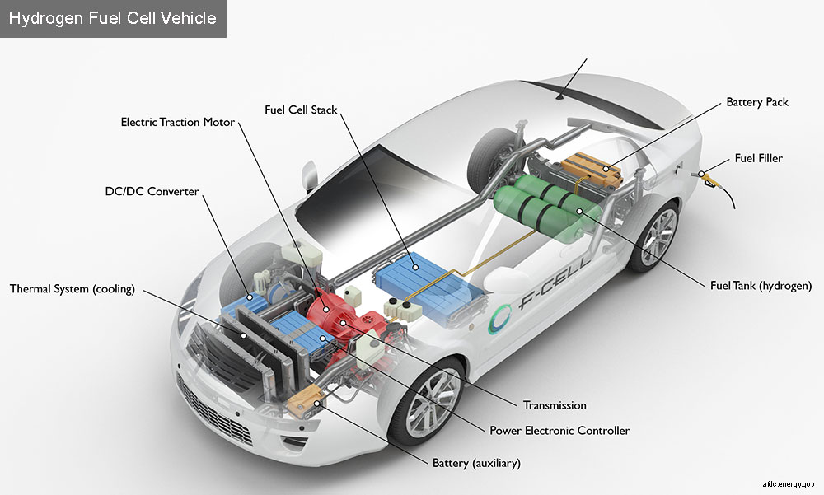
FCEVs
Fuel Cell Electric Vehicles
Heat and water
MOFs increase H storage capacity
Less bulky
Increased mileage
Numerous tax incentives
Cheaper to run than ICMs or electric vehicles within 10 years
Attract investors
Establish Euro-Technologies
https://afdc.energy.gov/vehicles/fuel_cell.html
Notes:
We propose using Fuel Cell Electric Vehicles as a way to attract investors and generate public support for alternative energy. We believe that Euro-Technologes has the potental to be at the forefront of FCEVs because the southeast has never seen anything like it. FCEVs with a MOF-Hydrogen storage system are great for the environment. they only produce heat and water as byproducts and have increased mileage due to their improved MOF hydrogen storage system.
In addition to numerous tax credits that incentivise FCEVs, they are also expected to be much cheaper to run than traditional internal combustion engine vehicles within the next ten years. When consumers see the reduced operating costs of FCEVs, they’ll flock to it and eagerly adopt hydrogen fuel cars as their main source of transportation
all these environmental benefits and economic incentives will curate a positive image both with potential investors and the public, thus increased adoption of alternative energy and attracting more investors.

Slide 17
BUDGET- PHASE 2
80,050,000
RFBs
$5,000,000
WIND
$15,000,000
SOLAR
$50,000,000
FCEVs
$10,000,000
Community Outreach
$50,000
Not to scale
Notes:
RFBs adjusted for solar only still need wind estimate
The cost of FCEVs and community outreach comes largely from the implementation of refueling stations. But once a large proportion of the public adopts FCEVs, each refueling station is guaranteed to be profitable, thus offsetting the initial implementation cost

Slide 18
STEP 4
Company gains profitability and increases market share
STEP 1
Establish RTO and spearhead the shift to alternative energy
Economic Incentives
STEP 3
Catch the eye of politicians, causing more favorable legislation.
Alt. energy production is easier with less red tape
STEP 2
Economic stimulation from increased regional jobs, domestic manufacturing, etc

Slide 19
Environmental Impacts
Water
Air
Solid Waste
Fracking
Emissions
Public Health
Coal Ash
Alternatives
Notes:
Water:
Reduced fracking with increased dependence on alt. fuel
Reduced runoff from coal ash sites
Air
Reduced particulates
Improved public health
Reduced nitric oxide emissions
Fewer emissions
Waste
Less coal ash and other waste products will be produced
Using waste products in other products such as concrete decrease waste

Slide 20
The Future
By 2030
Reduced emissions
Establish RTO
Grow renewables
By 2050
Diverse renewables
Thinned non renewables
Carbon neutral or negative
Notes:
By 2030 emissions from currently operating coal and natural gas power plants will be reduced
An RTO will be established to enable the growth of renewables and reinvigorate economic competition
A diverse portfolio of renewable will be developed and a thinned portfolio of nonrenewable sources will be maintained
By 2050 the companies assets will be carbon neutral or preferably carbon negative

Slide 21
THANKS
Does anyone have any questions?
Jessica Boyette
jessicaboyette@ufl.edu
Hunter Kaminski
hkaminski@ufl.edu
Alyssa Morea
alyssamorea@ufl.edu
Michael Orense
morense@ufl.edu
Notes:
jess: public policy advisor

