Slide 1
Decarbonization Resource Plan
Response to Request for Proposal
To: Euro-Technologies Board of Investors, Southeast Public Service Commission
David Flores
Energy Engineer
Madeline Larsen
Project Manager
Kelly Milbrandt
Technology Specialist

Slide 2
The Problem

Slide 3
Relevant Regulations
Safe Drinking Water Act
Clean Air Act
New Source Performance Standards
Existing Source Performance Standards

Slide 4
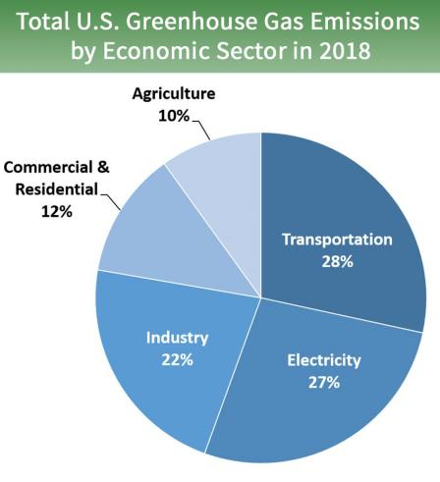
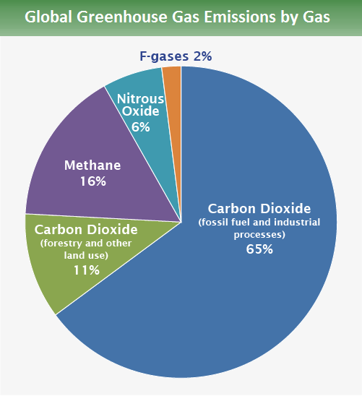
Greenhouse Gases and Carbon Emissions
Methane
Carbon dioxide
Water vapor

Slide 5
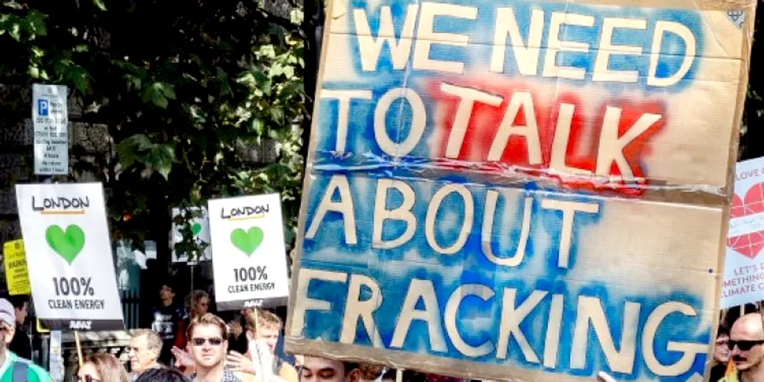
Challenges: Investment in the Future
Carbon taxes
Aging infrastructure
Public opinion
Fracking
Human health

Slide 6
Methods, Resources, and Proposed Solutions

Slide 7
Phase I
Community Outreach and Organization
2021-2024

Slide 8
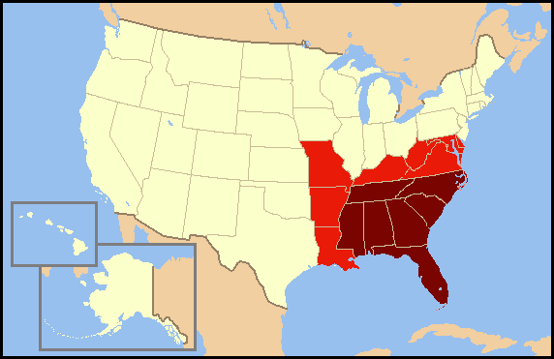
Southeastern United States Representation

Slide 9
NGO Cooperation and Regulatory Compliance

Slide 10
Phase II
Decreasing Carbon Emissions
2024-2030

Slide 11
Implementation: Carbon Reduction
Construction
Goal: Minimizing further damage
Laying foundations
Permitting
Planning future construction
Reliance on “compromises”

Slide 12
Proposed Solutions: Phase II
Hybrid coal-solar power
Biomass co-fire
Air pollution control devices
Oxyfuel combustion

Slide 13
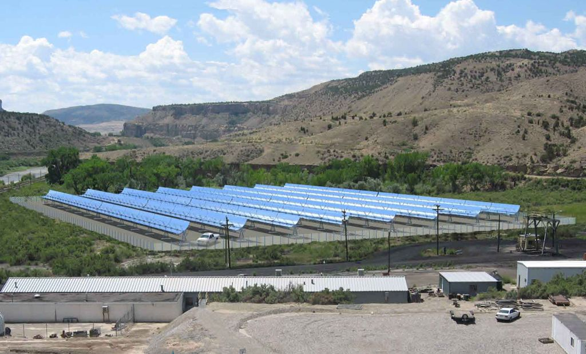
Hybrid coal-solar power
Cameo Generating Station, Palisade in Colorado
Notes:
Colorado

Slide 14
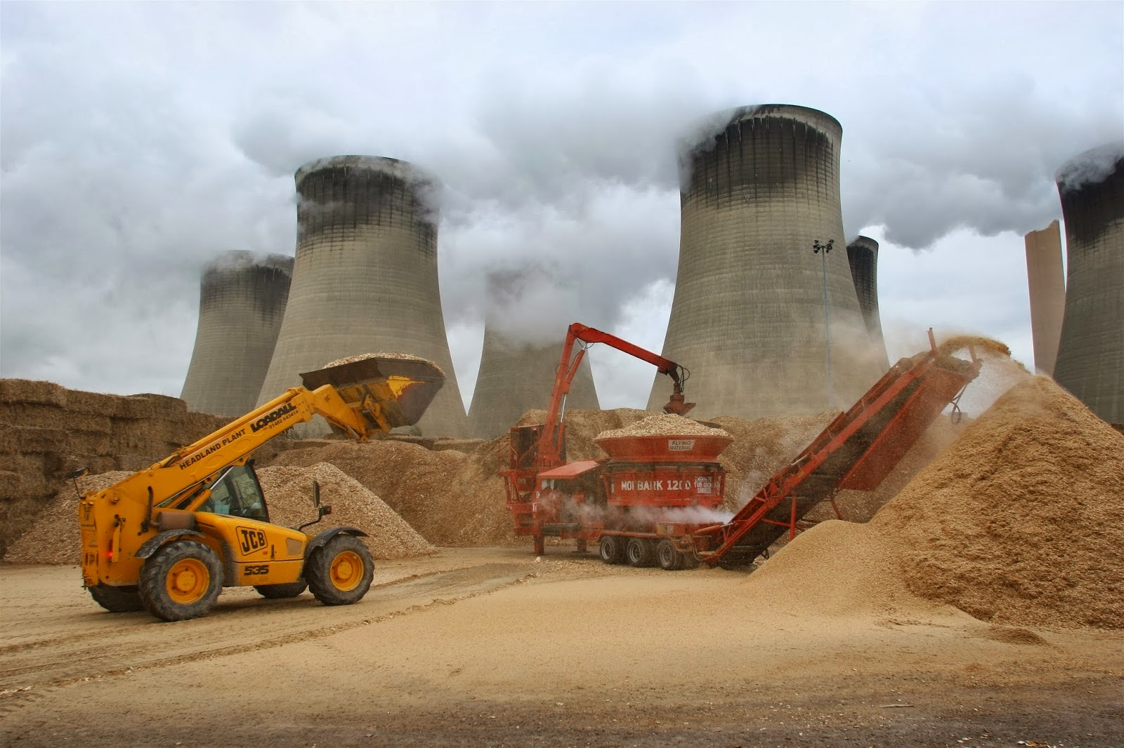
Biomass Co-Fire

Slide 15
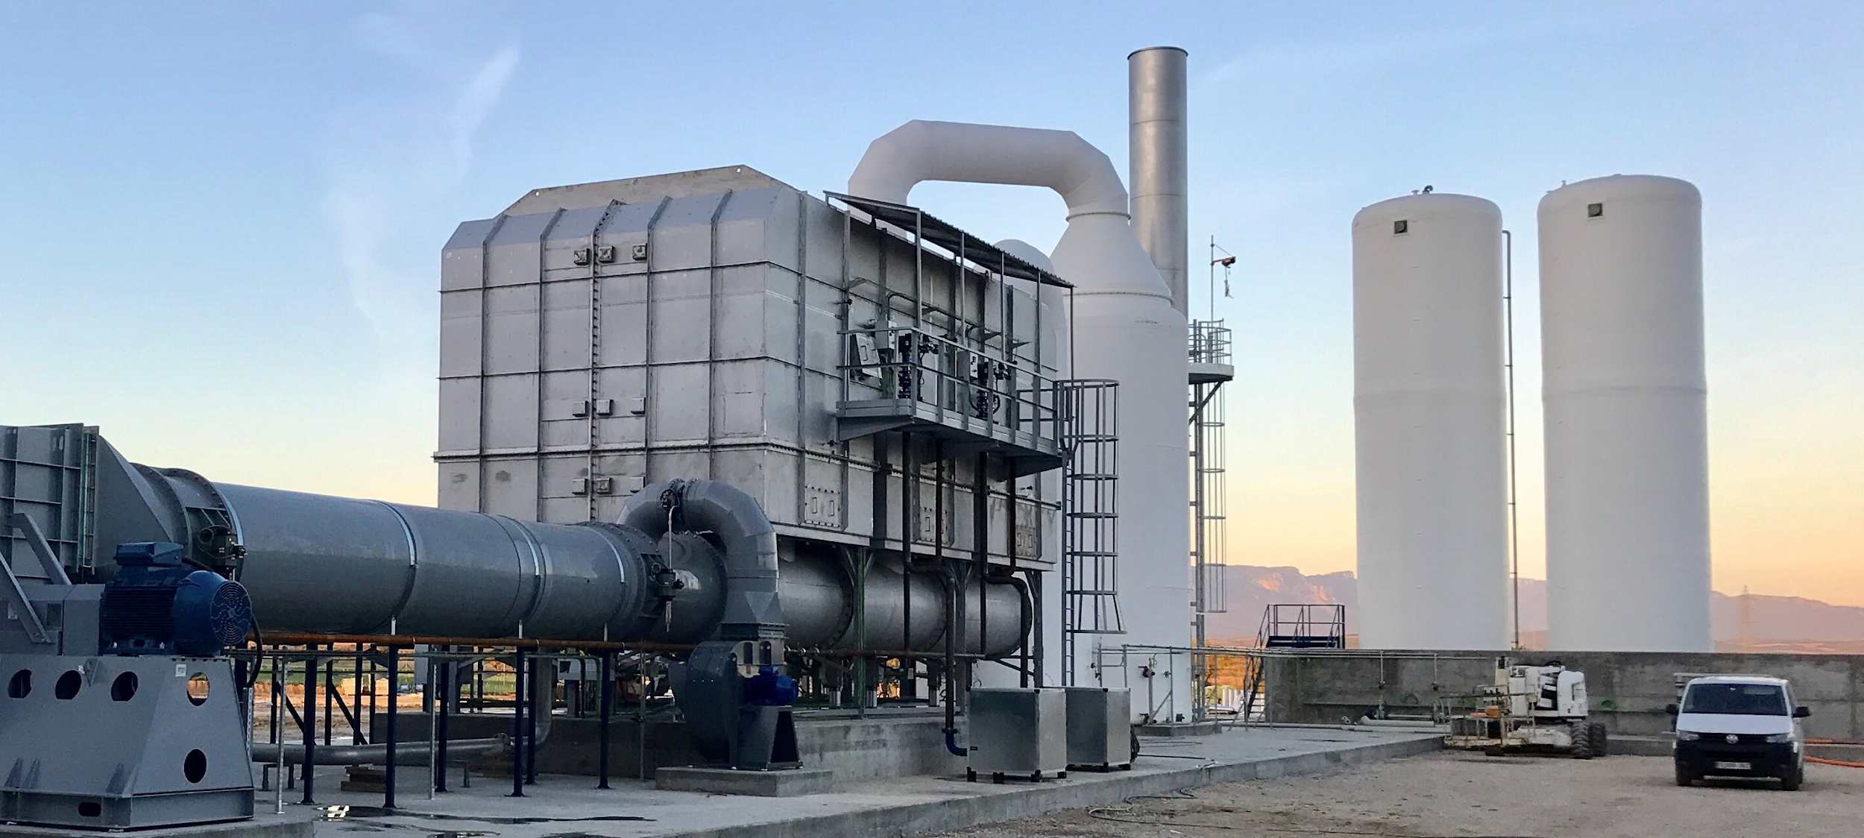
Air Pollution Control Devices

Slide 16
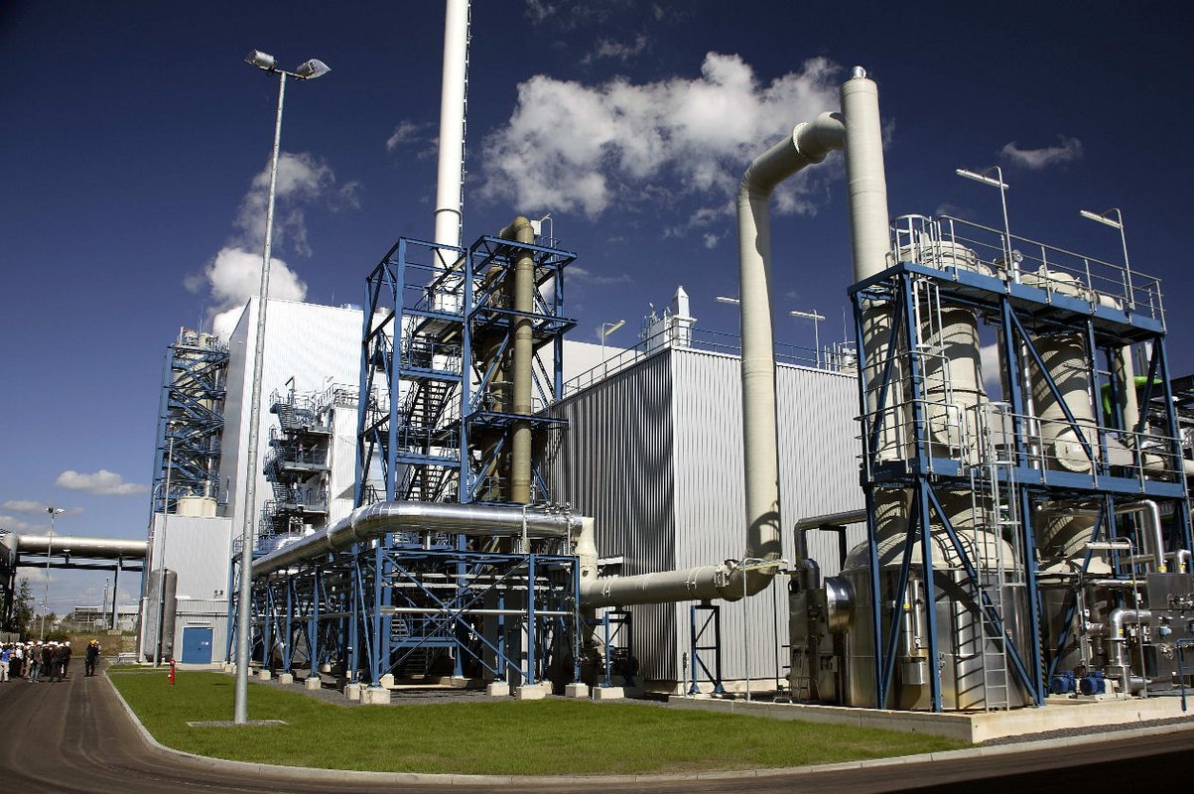
Oxyfuel Combustion
Oxyfuel plant in Schwarze Pumpe, Germany
Notes:
No need to add nitrogen

Slide 17
Phase III
Complete Decarbonization
2030-2050

Slide 18
Implementation: Complete Decarbonization
Understanding local communities
Cooperation with regulatory bodies
Tailored approaches to a community’s resources
Transparency
Accountability to the public
Creative approaches to funding

Slide 19
Proposed Solutions: Phase III
NUCLEAR
SOLAR
WIND
HYDROELECTRIC
GEOTHERMAL
Producing energy through the fission of Uranium
Producing energy from solar rays
Producing energy from wind
Producing energy from water resources
Producing energy from the Earth’s heat

Slide 20
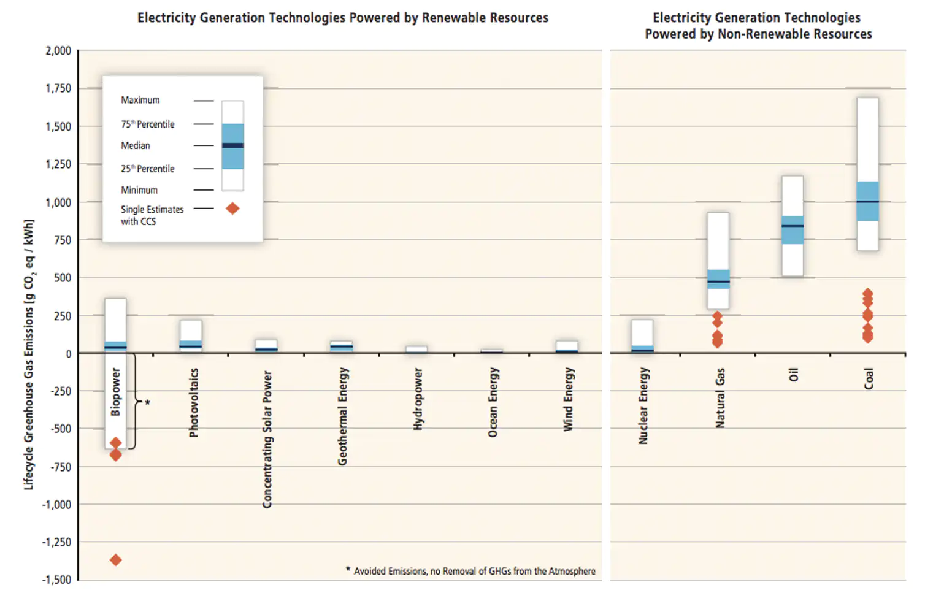
Carbon Dioxide Emissions

Slide 21
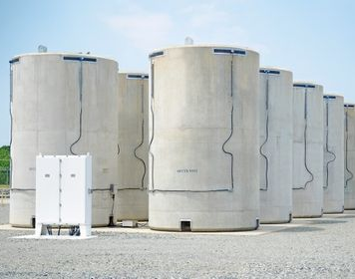
Nuclear Energy
Dry Cask Storage

Slide 22
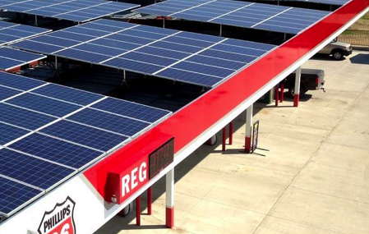
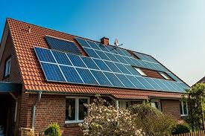
Solar Energy
Creative Ways to Save Space

Slide 23
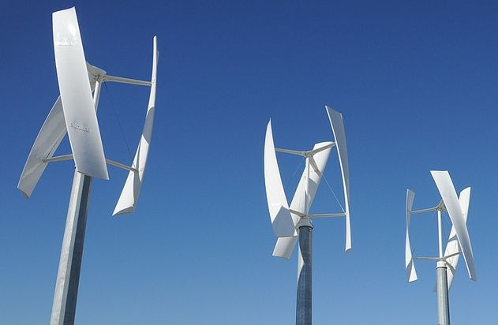
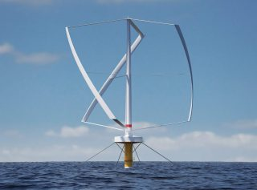
Wind Energy
Vertical-Axis Turbines
Offshore wind farms

Slide 24
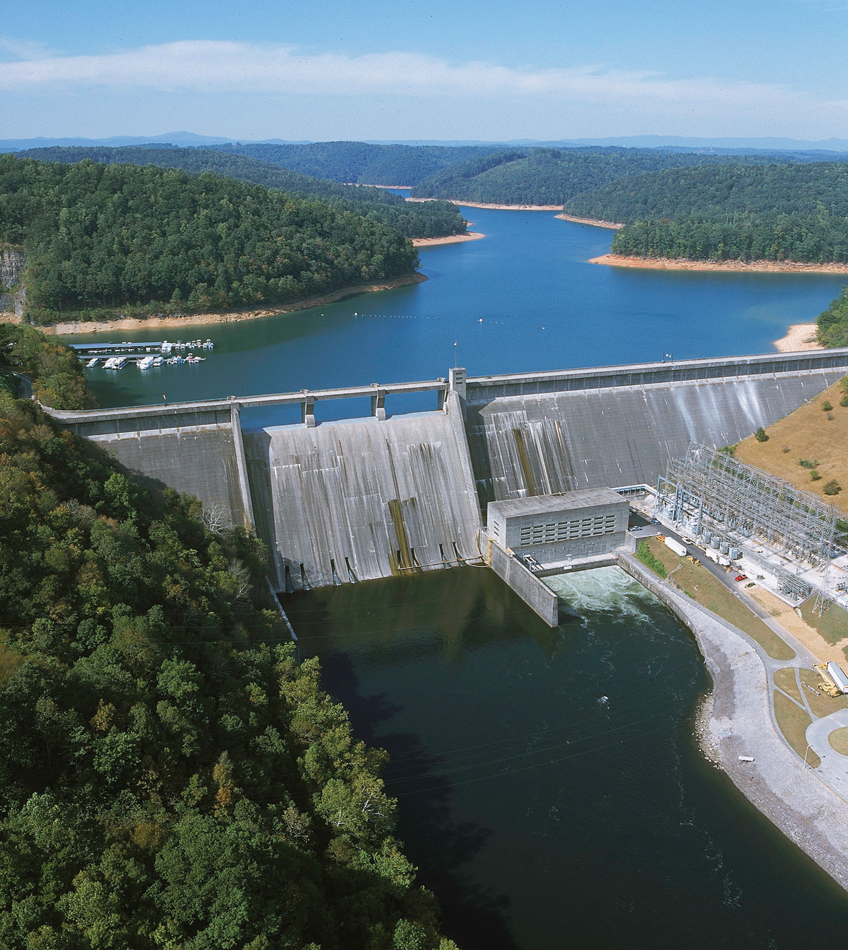
Hydroelectric Energy
Tennessee River Valley Authority

Slide 25
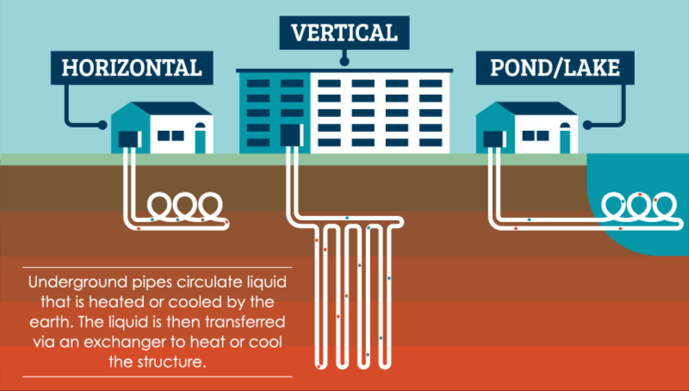
Geothermal Energy
Closed-Loop System

Slide 26
Approaches to Funding
Applications for federal and state funds
Partnerships with universities
Strong relationships with NGOs
Appeals to investors
Some cost displaced to consumers

Slide 27
Conclusion

Slide 28
CREDITS
Presentation template by Slidesgo
Icons by Flaticon
https://www.epa.gov/ghgemissions/sources-greenhouse-gas-emissions
https://www.epa.gov/ghgemissions/global-greenhouse-gas-emissions-data
https://www.epa.gov/sites/production/files/2016-05/global_emissions_gas_2015.png
https://www.lhsfna.org/index.cfm/lifelines/august-2019/hundreds-of-workers-sickened-or-killed-following-coal-ash-cleanup/
https://world.edu/international-cooperation-is-the-key-to-global-recovery/
https://www.director.co.uk/6-ways-to-reduce-the-carbon-footprint-of-your-business/
https://phys.org/news/2010-07-hybrid-solar-coal-power.html
https://www.buildingindiana.com/decarbonization-is-in/

Slide 29
Questions?

