Slide 1
U.S. EPA Region 4
Regulatory Update
Joint Coastal Plains AWMA
October 29, 2020
Caroline Y. Freeman
U.S. Environmental Protection Agency, Region 4
Atlanta, GA

Slide 2
Today’s Topics
Administrative Updates
Air Program Update
Air Quality Improvements
Progress on NAAQS and Haze Implementation
Clean Air Act Regulatory and Policy Activity
Voluntary Activities
Questions

Slide 3
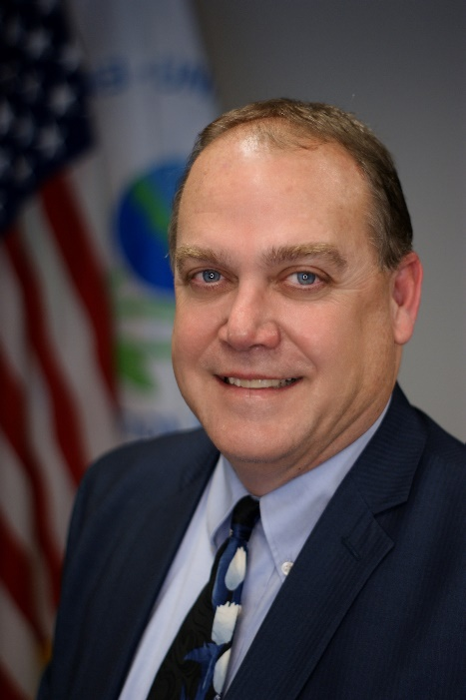
New Senior Management
Mary S. Walker
Regional Administrator
EPA Region 4
John Blevins
Acting Deputy Regional Administrator
EPA Region 4

Slide 4
EPA Regional Office Reorganization
Office of the Regional Administrator
Gulf of Mexico Division
Office of Regional Counsel
Mission Support Division
Lab Services and Applied Sciences Division
Enforcement & Compliance Assurance Division
Air and Radiation Division
Water Division
Superfund and Emergency Response Division
Land, Chemicals and Redevelopment Division

Slide 5
Some EPA Focus Areas – National and R4
NAAQS
129 Rules
Affordable Clean Energy Rule
Landfills
MM2A
NSR
Region 4 is working with its stakeholders to implement the regulatory requirements of the Clean Air Act and to look for risk reduction opportunities through voluntary efforts

Slide 6
Comparison of Growth vs Emissions
www.epa.gov/airtrends

Slide 7
EPA National Designations
Agency Priority Goal: By September 30, 2022, EPA, in close collaboration with states, will reduce the number of nonattainment areas to 101 from a baseline of 166.

Slide 9
NAAQS Reviews
NAAQS Review Status
(August 2020)
 | Ozone | Lead | Primary NO₂ | Primary SO₂ | Secondary (Ecological) NO₂, SO₂, PM¹ | PM² | CO
Last Review Completed (final rule signed) | Oct. 2015 | Sept 2016 | April 2018 | Feb 2019 | Mar 2012 | Dec 2012 | Aug 2011
Recent or Upcoming Major Milestone(s) | Sept/Oct 2019 Draft ISA and Draft PA³ Early 2020 Proposal Late 2020 Final | TBD⁴ | TBD | TBD | Timing of next steps is TBD Final ISA; draft REA/PA | Dec 2019 Final ISA Jan 2020 Final PA April 30, 2020 Proposal Late 2020 Final | TBD
(May 2020)
Additional information regarding current and previous NAAQS reviews is available at: https://www.epa.gov/naaqs
¹ Combined secondary (ecological effects only) review of NO₂, SO_{2,} and PM
² Combined primary and secondary (non-ecological effects) review of PM
³ IRP – Integrated Review Plan; ISA – Integrated Science Assessment; REA – Risk and Exposure Assessment; PA – Policy Assessment
⁴ TBD = To be determined

Slide 10
2010 SO₂ Designations Process
Rounds 1-3
EPA currently has one area designated as nonattainment in one state in Region 4
Round 1: Completed August 2013 – EPA Region 4 designated 5 areas nonattainment based on existing monitors violating the standard*
Round 2: Completed June 30 and November 29, 2016 – EPA designated 65 areas in 24 states based on air dispersion modeling and 2013-2015 violating monitors (6 areas designated in Region 4)
Round 3: Completed December 21, 2017 and March 28, 2018 – EPA completed an additional round of designations for all remaining undesignated areas except where states have deployed new monitoring networks by January 1, 2017 if executed under the SO₂ Data Requirements Rule (DRR); one new area was designated nonattainment
Round 4: By December 31, 2020 – EPA must complete designations for all remaining areas (based on 2017-2019 monitoring data)
www.epa.gov/so2-pollution/applying-or-implementing-sulfur-dioxide-standards

Slide 11
Proposed OSWI Amendments
8/31/2020: EPA promulgated new source performance standards (NSPS) and emission guidelines (EG) for new and existing ‘‘other’’ solid waste incineration units (OSWI). EPA is proposing to amend the standards for small OSWI units by:
Amending rule applicability provisions to recognize that some units previously subject to the Commercial and Industrial Solid Waste Incineration (CISWI) rule are OSWI units.
Increasing testing and monitoring flexibilities so small units with rudimentary designs can demonstrate compliance with the OSWI rule.
To address some issues that resulted in a voluntary remand of the 2005 OSWI rule, the Agency is also proposing to revise standards for small OSWI units based on data from representative units.
EPA is proposing other minor amendments to the rule, including:
the applicability of title V permitting for certain ACIs
revised regulatory provisions related to emissions during periods of startup, shutdown and malfunction; and
provisions for electronic reporting of certain notifications and reports.

Slide 12
Affordable Clean Energy Rule (ACE)
Final ACE Package includes three distinct, separate, and independent actions:
Repeal of the Clean Power Plan (CPP)
ACE (Emission Guidelines for Greenhouse Gas Emissions from Existing Electric Utility Generating Units)
Revisions to Clean Air Act section 111(d) Emission Guidelines Implementing Regulations
ACE published in the Federal Register 7/8/19
New Source Review (NSR) reform not promulgated with ACE
EPA intends to take action at a later date
State plans due 7/8/22 (three years from publication of final rule)
https://www.epa.gov/stationary-sources-air-pollution/affordable-clean-energy-rule

Slide 13
Landfills – Recent Rulemakings
08/26/19: EPA issued final rules related to the timing and implementation of the 2016 emission guidelines for existing MSW landfills
Final rule aligned state plan timing requirements with the updated CAA Section 111(d) implementing regulations that were finalized with the ACE rule on 7/8/19 (40 CFR Part 60 Subpart Ba).
03/09/20: EPA issued notice of failure to submit 111(d) plans for existing landfills
Notice applies to 42 states and territories, including all eight Region 4 states
03/26/20: EPA finalized Amendments to the Landfill Emission Guidelines
https://www.epa.gov/stationary-sources-air-pollution/municipal-solid-waste-landfills-new-source-performance-standards

Slide 14
Reclassification of Major Sources as Area Sources Under Section 112
Final Rule Signed 10/1/2020 - Effective 60 days after publication
Implements the January 25, 2018 EPA memorandum which withdrew the 1995 Once-In-Always-In Policy (OIAI)
Amends the National Emission Standards for Hazardous Air Pollutants (NESHAP) General Provisions
Provides sources that have lowered HAP emissions to below major source thresholds the flexibility to reclassify to area source status
https://www.epa.gov/stationary-sources-air-pollution/reclassification-major-sources-area-sources-under-section-112-clean
www

Slide 15
Reclassification of Major Sources as Area Sources Under Section 112
Benefits reclassified sources due to reduced compliance burden
Exempts some reclassified sources from the requirement to obtain an operating permit under Title V of the CAA
Some of these sources possibly become subject to CAA section 112 area source requirements rather than major source requirements
Encourages sources with emissions above major source thresholds to evaluate their operations and consider changes that can further reduce their HAP emissions to below the major source thresholds
https://www.epa.gov/stationary-sources-air-pollution/reclassification-major-sources-area-sources-under-section-112-clean
www

Slide 16
Title V & NSR Permitting
Rulemakings & Guidance in Progress
Final Title V Petitions Process Rulemaking – Final Rule Published 2/5/2020.
Rule effective April 6, 2020.
Provides mandatory content, format, and submission process.
Clarifies the timing of EPA’s 45-day review period and the citizen petition deadline under parallel review (105 days vs. 135 days used by Region 4).
Reaffirms that response to significant comments is mandatory.
Region 4 will continue to calculate and post petition deadlines on our website.
NSR Error Corrections Rulemaking, proposed 11/22/19.
Proposed rulemaking suggests air agencies make these changes in conjunction with other SIP submittals.
https://www.epa.gov/nsr

Slide 17
Title V & NSR Permitting
Electronic Permits System (EPS)
New system for EPA receipt and comment on State/local permits.
Went live for State and locals permitting authorities in March 2020.
Region 4 is providing training to our permitting agencies and will be working with those interested in connecting their database to EPS.
Includes an optional dashboard that permit authorities can use for public notices.
Has been piloted by several permit agencies and ECOS.
Ultimately will replace TOPS reporting and the BACT/LAER Clearinghouse.

Slide 18
Questions?
Caroline Y. Freeman
Freeman.Caroline@epa.gov

